Slide 1

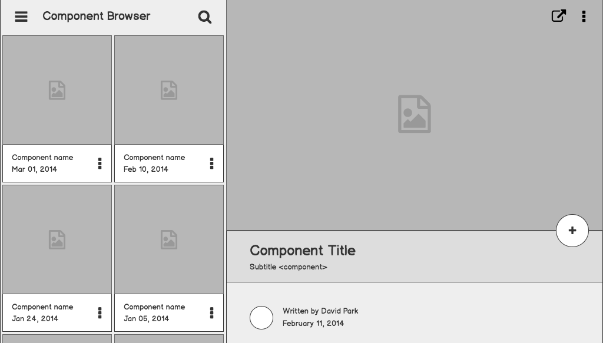

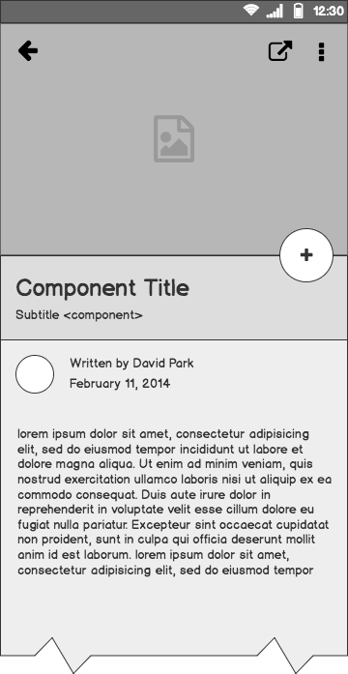
Pwani Teknowgalz Flutter Curriculum
Developing mobile apps using Flutter, parse and firebase

Slide 2
Outline
Introduction to Programming
Introduction to Dart
Flutter Development
User Interface
Backend and State Management
EXTRA: Push notifications
EXTRA: APIs with Flutter
EXTRA: Monetization with Pesapal
What Next?
Questions?

Slide 3
Introduction to Programming

Slide 4
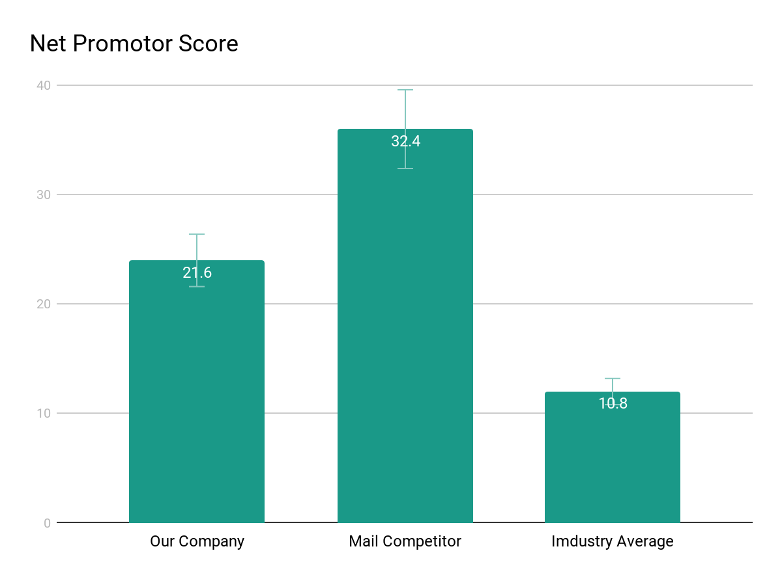
What is Programming?
1
List any research or data you have to support the need for a solution.

Slide 5
Introduction to Dart

Slide 6
Dart as a programming language
1
List any research or data you have to support the need for a solution.

Slide 7
Flutter development

Slide 8
What is Flutter?
1
List any research or data you have to support the need for a solution.

Slide 9
User Interface

Slide 10
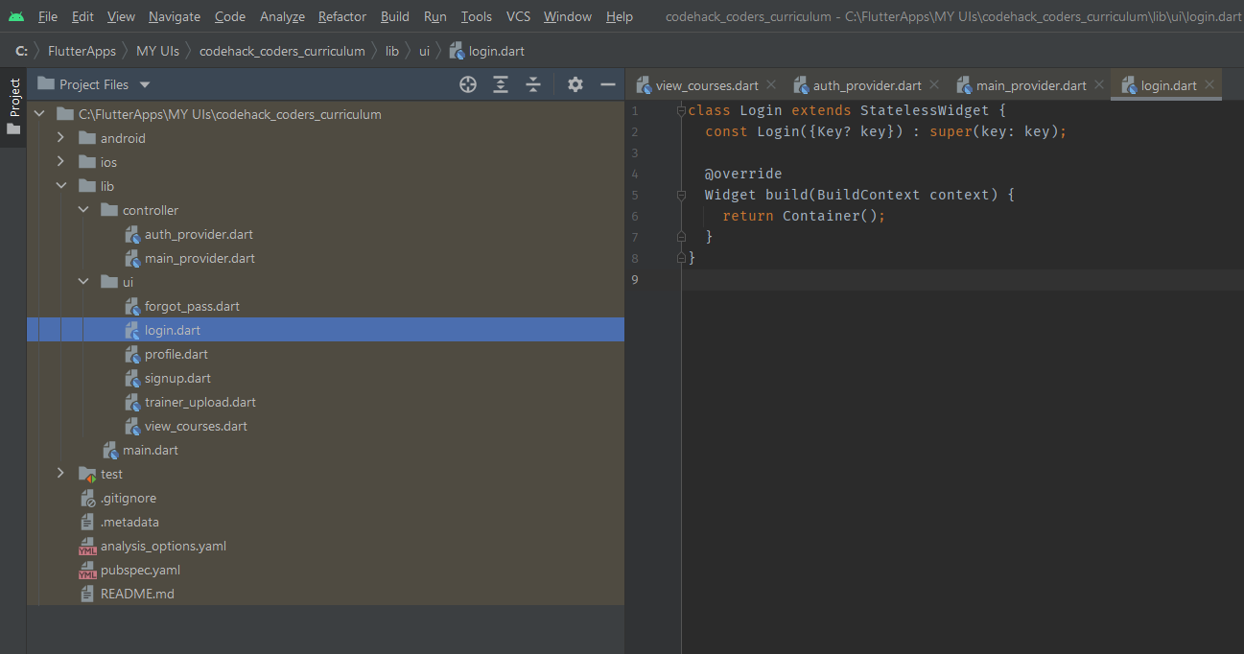
User Interface Development
1
In the lib folder, create 3 main folders. Name them controller and ui. The controller will contain backend, while ui will contain the frontend. Create files inside them and structure as follows:
The controller contains auth_provider.dart and main_provider.dart
The ui contains forgot_pass.dart, login.dart, profile.dart, signup.dart, trainer_upload.dart and view_courses.dart
Use the stless command to create the classes and name them appropriately

Slide 11
Backend Setup and State Management

Slide 12
Backend and State Management
1
List any research or data you have to support the need for a solution.

Slide 13
EXTRA: Push notifications

Slide 14
Push notifications with Firebase
1
List any research or data you have to support the need for a solution.

Slide 15
EXTRA: API with Flutter

Slide 16
APIs with Flutter
1
List any research or data you have to support the need for a solution.

Slide 17
EXTRA: Monetization with Pesapal

Slide 18
Monetization with Pesapal
1
List any research or data you have to support the need for a solution.

Slide 19
Next Steps

Slide 20
What next?
Present the timeline.
Solicit comments on these slides or reviews on these wireframes in the Balsamiq add-on.
User testing plan.

Slide 21
Questions?

Slide 22
References

